Slide 1

SCHOOL OF COMPUTER ENGINEERING & TECHNOLOGY
Project Stage 1 – Review

Slide 2

Enhancing Hospital Care: Predicting Length of Stay & Mortality Risks of Patients using Advanced Machine Learning Techniques.
Name: Abhishek S Waghchaure
Roll No: PA20
PRN: 1032221714
Guide: Prof. Deepali Javale

Slide 3
Agenda
Introduction
Objective
Background & Motivation
Literature review
Identifying Research gap
Architecture
Conclusion

Slide 4
Introduction:-
Title: Skin Cancer Prediction Using Deep Learning Techniques / AI-Driven Skin Cancer Detection for Early Intervention using Deep Learning.
Skin cancer is one of the most rapidly spreading illnesses in the world and has become formidable global health challenge, with its incidence steadily increasing and posing significant health and economic burdens.
Early detection of skin cancer is crucial accurate diagnosis of skin cancer identification for preventive approach in general.
Early detection and accurate classification of skin cancer are pivotal for improving patient outcomes and addressing the evolving landscape of this disease
In response to this pressing need, our research project seeks to develop an innovative and robust system for the detection and classification of skin lesions, utilizing cutting-edge computer vision and machine learning technologies.

Slide 5
Objective :-
Our research project seeks to develop an intelligent and accurate system for skin cancer detection and classification.
By leveraging the power of computer vision and machine learning, we aim to create a solution that is not only highly accurate but also accessible to a broad spectrum of the population, bridging the gap in diagnostic capabilities.
Through this work, we aspire to contribute to the early detection and classification of skin cancer, ultimately improving patient outcomes and reducing the global burden of this prevalent disease.

Slide 6
Background
Skin cancer is a prevalent and potentially life-threatening medical condition that arises when skin cells undergo malignant transformation.
Causes: - Spending more amount of time in the UV light coming from sun. - Smoking heavily, fall of hair and change of color. - Growth of moles and different shapes. - Family history of skin cancer etc.
Prevalence and Incidence of Skin Cancer: Skin cancer is one of the most frequently diagnosed cancers worldwide. According to the World Health Organization, there are more than 5 million new cases of skin cancer diagnosed each year.
Importance of Early Detection: - Early detection of skin cancer is associated with significantly improved outcomes. When detected at an early stage, skin cancer is highly curable, typically involving minor surgical procedures. - In contrast, advanced-stage skin cancer often requires more aggressive and invasive treatments, leading to a reduced likelihood of survival and a lower quality of life for affected individuals.

Slide 7
Background
Current Methods for Skin Cancer Detection: The current standard for skin cancer detection involves visual examination by dermatologists, where they assess skin lesions for characteristics such as size, shape, color, and changes over time. Dermoscopy, a technique that involves using a handheld magnifier, is also commonly employed to aid in the examination. Biopsies are conducted to confirm a diagnosis. While these methods have proven effective to some extent, they have limitations, including subjectivity, interobserver variability, and the requirement for specialized expertise. Moreover, access to dermatologists may be limited in some regions, resulting in delayed diagnosis and treatment.
Technological Advancements: Recent advancements in computer vision and machine learning have opened up new possibilities for the automated detection and classification of skin lesions. These technologies allow for the analysis of images of skin lesions, enabling rapid, objective, and consistent evaluation. Machine learning algorithms can be trained on large datasets of dermatological images to identify patterns and features associated with different skin cancer types. This research project aims to harness these technological advancements to develop a robust and efficient system for skin cancer detection and classification

Slide 8
Motivation
Current Limitations: Currently, skin cancer detection methods primarily rely on visual examination and biopsies, which can be subjective, costly, and time-consuming. Moreover, the accuracy of these methods, especially in distinguishing between benign and malignant lesions, is not always reliable. As a result, a large number of cases go undetected until they reach advanced stages.
Importance of Early Detection: Early detection of skin cancer is critical for increasing the chances of successful treatment and, ultimately, saving lives. Research has shown that when skin cancer is identified in its initial stages, the five-year survival rate is notably higher.
Technological Advancements: Recent advancements in computer vision, machine learning, and dermatology offer an exciting opportunity to revolutionize the field of skin cancer detection.
Societal Implications: The outcomes of this research extend beyond individuals; they hold the potential to transform healthcare and reduce the economic burden on healthcare systems. By improving early detection, we can facilitate timely intervention, reduce treatment costs, and enhance the quality of life for individuals at risk of skin cancer.

Slide 9
Base Paper
Introduction:
R Raja Sekar; Y Jagan Mohan Reddy; K Nani; C Sai Prathap Reddy; K Chiranjeevi; K Vikram, “Skin Cancer Prediction Using Deep Learning Techniques”, 2023 4th International Conference on Signal Processing and Communication (ICSPC), IEEE Conference, 2023.
Methodology: In this base paper they have used ResNet Model, and used 3 (multi classes) for classification 1. Melanoma 2. Basal cell Carcinoma 3. Squamous cell skin cancer. Accuracy achieved 82.7 %.
Dataset: The authors utilized a dataset containing 10000 images for skin cancer which can be classified into 2 or 3 or 7 classes. The name of Dataset is HAM10000 and is is available on Kaggle.

Slide 10
Research Gap
In this base paper they have used ResNet Model, and used 3 (multi classes) for classification 1. Melanoma 2. Basal cell Carcinoma 3. Squamous cell skin cancer. Accuracy achieved 82.7 %
We can use different dataset which has 7 classes for skin cancer namely Actinic keratoses and intraepithelial carcinoma (akiec), basal cell carcinoma (bcc), benign keratosis-like lesions (bkl), dermatofibroma (df), melanoma (mel), melanocytic nevi (nv), and pyogenic granulomas and hemorrhage (vasc) and use different CNN architecture.
Also they have not performed any kind of image preprocessing to remove any kind of obstructions.
Handling dataset imbalances.
Use different variant of CNN for this classification.
Perform and test different optimizers and callback functions for optimum and highly accurate model.

Slide 11

Literature Survey
Sr no | Paper Title, Authors, year of publication | Concepts described in the paper | Gaps in the paper
1 | Link : https://ieeexplore.ieee.org/document/10126035 Year : 2023 Name : Skin Cancer Prediction Using Deep Learning Techniques Authors : R Raja Sekar; Y Jagan Mohan Reddy; K Nani; C Sai Prathap Reddy; K Chiranjeevi; K Vikram | In this base paper they have used ResNet Model, and used 3 (multi classes) for classification 1. Melanoma 2. Basal cell Carcinoma 3. Squamous cell skin cancer. Accuracy achieved 82.7 % | We can use different dataset which has 7 classes for skin cancer namely Actinic keratoses and intraepithelial carcinoma (akiec), basal cell carcinoma (bcc), benign keratosis-like lesions (bkl), dermatofibroma (df), melanoma (mel), melanocytic nevi (nv), and pyogenic granulomas and hemorrhage (vasc) and use different CNN architecture.
2 | Link : https://doi.org/10.1109/ACCESS.2023.3294974 Year : 13 July 2023 Name : Performance Enhancement of Skin Cancer Classification Using Computer Vision Authors : Ahmed Magdy; Hadeer Hussein; Rehab F. Abdel-Kader | The performances of the two proposed models, KNN- PDNN and AlexGWO, are compared to most of ML and DL approaches. | The research mentions the use of pretrained deep networks, but there's room to explore the effectiveness of transfer learning techniques and data augmentation methods specifically tailored to dermoscopic images.

Slide 12
3 | Link : https://doi.org/10.1109/ACCESS.2023.3274848 Year : 10 may 2023 Name : DeepSkin: A Deep Learning Approach for Skin Cancer Classification Authors : H. L. Gururaj; N. Manju; A. Nagarjun; V. N. Manjunath Aradhya; Francesco Flammini | the research paper discusses the significance of early detection of skin cancer, the challenges in distinguishing between benign and malignant lesions, and the role of deep learning, specifically CNNs, in automating the detection process, with an emphasis on their superior performance compared to human experts. | In this paper only binary classification is performed as cancerous and not cancerous but we can perform multiclass classification based on types of skin cancer.
4 | Link : https://doi.org/10.3390/app131810076 Year : 7 Sep 2023 Name : An Identification Method of Feature Interpretation for Melanoma Using Machine Learning Authors : Zhenwei Li , Qing Ji , Xiaoli Yang, Yu Zhou and Shulong Zhi | The research employs various classification algorithms, including Support Vector Machine (SVM) with four different kernels, Logistic Regression (LR), and Gaussian Naive Bayes (GaussianNB). These classifiers are used to make predictions based on the selected features. | The paper primarily focuses on texture, color, and shape features for melanoma recognition. A research gap could involve investigating the potential utility of additional feature types, such as deep learning-based features or more advanced texture and shape descriptors.

Slide 13
5 | Link : https://doi.org/10.1109/ACCESS.2023.3269694 Year : 24 April 2023 Name :An Interpretable Skin Cancer Classification Using Optimized Convolutional Neural Network for a Smart Healthcare System Authors :Krishna Mridha; Md. Mezbah Uddin; Jungpil Shin; Susan Khadka; M. F. Mridha | Class Imbalances problems are addressed. It trains the CNN model using two optimization functions (Adam and RMSprop) and three activation functions (Relu, Swish, and Tanh). Also incorporates techniques like Grad-CAM and Grad-CAM++ to provide explanations for the model's decisions. | The gap is in the development of effective methods and tools that can bridge the gap between the model's decision-making process and the user's comprehension. This is crucial because users, such as clinicians or even patients, need to trust and understand the model's outputs for informed decision-making in the context of skin cancer.
6 | Link : https://doi.org/10.1016/j.imu.2019.100282 Year : 2020 Name : Skin cancer detection: Applying a deep learning based model driven architecture in the cloud for classifying dermal cell images Authors : Mohammad Ali Kadampur, Sulaiman Al Riyaee | The introduction concludes by stating that the machine-assisted diagnosis presented in the paper aims to overcome the problems of delay, accuracy, and the scarcity of dermatologists in public health. | The paper pointed at the provision of obtaining the programming code for the model for further exploration by the programming specialist. The provision to download the trained model and develop enterprise level applications is the best seed level research that this paper observes for the future work.

Slide 14
7 | Link : https://doi.org/10.3390/ijerph18105479 Year : 20 May 2021 Name : Skin Cancer Detection: A Review Using Deep Learning Techniques Authors : 1, Shumaila Akram 2, Muhammad Irfan 3, Hikmat Ullah Khan 4, Muhammad Ramzan 2,5,*, Abdur Rehman Mahmood 6, Soliman Ayed Alsaiari 7, Abdul Hakeem M Saeed 8, Mohammed Olaythah Alraddadi 9 and Mater Hussen Mahnashi | This Review paper presents a detailed systematic review of deep learning techniques for the early detection of skin cancer.
8 | Link : https://doi.org/10.1109/ACCESS.2020.2997710 Year : 26 May 2020 Name : Automatic Skin Cancer Detection in Dermoscopy Images Based on Ensemble Lightweight Deep Learning Network Authors : Lisheng Wei Anhui Key Laboratory of Electric Drive and Control, Anhui Polytechnic University, Wuhu, China ; Kun Ding; Huosheng Hu | The research paper focuses on developing a lightweight skin cancer recognition model with feature discrimination to improve the accuracy of dermoscopy image lesion detection. The proposed model incorporates two feature extraction modules and applies a model fusion strategy. Additionally, a lightweight semantic segmentation model for lesion area detection is developed. The research concludes that the proposed method outperforms existing deep learning-based approaches in the context of melanoma detection. | The conclusion mentions that the proposed framework achieves performance comparable to or better than existing methods. However, it doesn't provide a detailed comparative analysis of these methods. Future research could conduct a more comprehensive and systematic comparison with a wider range of existing approaches to highlight the specific strengths and weaknesses of the proposed method.

Slide 15
9 | Link : https://doi.org/10.1007/s40257-020-00574-4 Year : March 2021 Name : The Importance of Incorporating Human Factors in the Design and Implementation of Artificial Intelligence for Skin Cancer Diagnosis in the Real World. Authors : Felmingham, C.M., Adler, N.R., Ge, Z. et al. | It is a review that emphasizes the shift from adversarial comparisons to collaborative approaches in the integration of AI for skin cancer diagnosis in clinical practice. It discusses the impact of human factors, cognitive errors, biases, and unintended consequences, and stresses the importance of incorporating this knowledge into AI technology design.

Slide 16
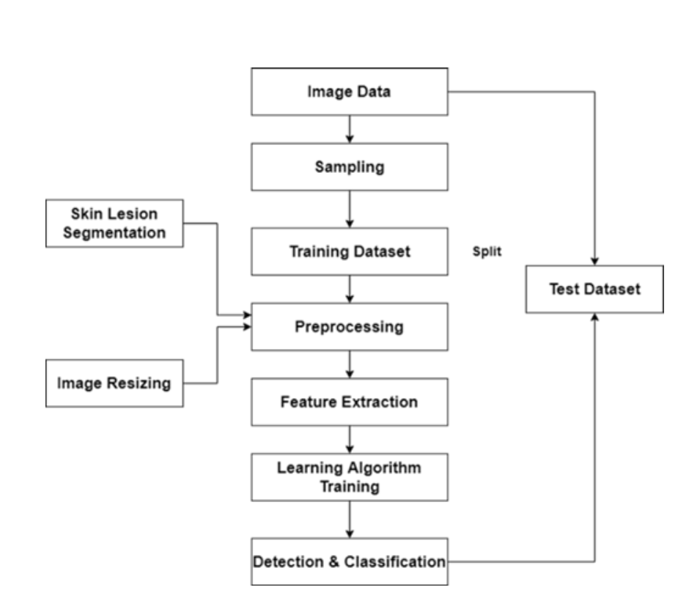
Architecture
Flow of Methodology

Slide 17
Methodology
Handling Dataset Imbalance :- As we are using the dataset HAM1000 which is originally divided in 3 equal classes of skin cancers, but when we use the same updated dataset for 7 classes there is imbalance that we need to handle.
Removing Noise :– Removal of Nosie like hairs and separating the lesion from any obstruction.
Segmenting : - Segmenting the lesion from the rest of the skin.
Training the model :- While compiling the model we can use different optimizers and callback functions and weight initializers to get the optimum model for our use case scenario.
Checking Accuracy :- We will check the accuracy of the model with confusion matrics, Fb score, accuracy and precision to understand the performance of it.

Slide 18
Conclusion
The conventional diagnostic methods, relying on subjective visual examination, face limitations, including interobserver variability and unequal access to dermatological expertise. Our system addresses these challenges, offering a highly accurate and accessible solution
The potential impact of our work is substantial. Our system's accuracy in identifying skin lesions and distinguishing between benign and malignant cases is promising. By incorporating user-friendly interfaces, like smartphone applications, we empower individuals to conduct self-examinations, facilitating early detection.
Beyond healthcare, our research holds the promise of reducing the economic burden on healthcare systems, improving patient outcomes, and enhancing the overall quality of life for skin cancer patients. Timely diagnosis and intervention increase the likelihood of successful treatment, potentially saving lives.
As we conclude, we recognize our work as a significant step in the fight against skin cancer, but not the final destination. Continuous research, algorithm refinement, and large-scale clinical trials are necessary to validate and enhance the system's performance.

Slide 19
Project Plan
Task No | Task | Start Date | End Date | Total Time
1 | Implementation of base paper code in Jupyter notebook and replicate the results. | 7 - 11 - 2023 | 9 - 11 - 2023 | 3 days
2 | Start working on the new multiclass dataset. (Data Cleaning/Transformation) | 10 - 11 - 2023 | 14 - 11 -2023 | 3 days
3 | Data Augmentation for handling imbalance classes. | 15 - 11 - 2023 | 17 - 11 - 2023 | 3 days
4 | Prepare the Proposed Model | 20 - 11 - 2023 | 23 - 11 - 2023 | 3 days
5 | Check Accuracy and optimize the CNN address overfitting if any. | 24 -11 -2023 | 27 – 11 - 2023 | 2 days
6 | Port the project from normal jupyter notebook to end to end project. | 28 - 11 -2023 | 1 -12 - 2023 | 4 days
7 | Prepare Static login page. | 4 -12 - 2023 | 5 -12 -2023 | 2 days
8 | Prepare basic UI for end to end approach. | 6 -12 - 2023 | 8 -12 -2023 | 3 days

Slide 20
References
R Raja Sekar; Y Jagan Mohan Reddy; K Nani; C Sai Prathap Reddy; K Chiranjeevi; K Vikram, “Skin Cancer Prediction Using Deep Learning Techniques”, 2023 4th International Conference on Signal Processing and Communication (ICSPC), IEEE Conference, 2023.
R. R. Sekar, Y. J. M. Reddy, K. Nani, C. S. P. Reddy, K. Chiranjeevi and K. Vikram, "Skin Cancer Prediction Using Deep Learning Techniques," 2023 4th International Conference on Signal Processing and Communication (ICSPC), Coimbatore, India, 2023, pp. 28-31, doi: 10.1109/ICSPC57692.2023.10126035.
Magdy, H. Hussein, R. F. Abdel-Kader and K. A. E. Salam, "Performance Enhancement of Skin Cancer Classification Using Computer Vision," in IEEE Access, vol. 11, pp. 72120-72133, 2023, doi: 10.1109/ACCESS.2023.3294974.
Li, Zhenwei, Qing Ji, Xiaoli Yang, Yu Zhou, and Shulong Zhi. 2023. "An Identification Method of Feature Interpretation for Melanoma Using Machine Learning" Applied Sciences 13, no. 18: 10076. https://doi.org/10.3390/app131810076

Slide 21
References
K. Mridha, M. M. Uddin, J. Shin, S. Khadka and M. F. Mridha, "An Interpretable Skin Cancer Classification Using Optimized Convolutional Neural Network for a Smart Healthcare System," in IEEE Access, vol. 11, pp. 41003-41018, 2023, doi: 10.1109/ACCESS.2023.3269694.
Mohammad Ali Kadampur, Sulaiman Al Riyaee,Skin cancer detection: Applying a deep learning based model driven architecture in the cloud for classifying dermal cell images,Informatics in Medicine Unlocked,Volume 18,2020,100282,ISSN 2352-9148,https://doi.org/10.1016/j.imu.2019.100282.
L. Wei, K. Ding and H. Hu, "Automatic Skin Cancer Detection in Dermoscopy Images Based on Ensemble Lightweight Deep Learning Network," in IEEE Access, vol. 8, pp. 99633-99647, 2020, doi: 10.1109/ACCESS.2020.2997710.
Felmingham, C.M., Adler, N.R., Ge, Z. et al. The Importance of Incorporating Human Factors in the Design and Implementation of Artificial Intelligence for Skin Cancer Diagnosis in the Real World. Am J Clin Dermatol 22, 233–242 (2021). https://doi.org/10.1007/s40257-020-00574-4

Slide 22
References
Felmingham, C.M., Adler, N.R., Ge, Z. et al. The Importance of Incorporating Human Factors in the Design and Implementation of Artificial Intelligence for Skin Cancer Diagnosis in the Real World. Am J Clin Dermatol 22, 233–242 (2021). https://doi.org/10.1007/s40257-020-00574-4
Dildar, M.; Akram, S.; Irfan, M.; Khan, H.U.; Ramzan, M.; Mahmood, A.R.; Alsaiari, S.A.; Saeed, A.H.M.; Alraddadi, M.O.; Mahnashi, M.H. Skin Cancer Detection: A Review Using Deep Learning Techniques. Int. J. Environ. Res. Public Health 2021, 18, 5479. https://doi.org/10.3390/ijerph18105479

